Slide 1
Data Visualization Project
Data Visualization
Name: Javio Felix

Slide 2
Data Visualization Problem 1:
What is the problem you want to solve in data analysis?
To help persons decide which seller type is safer or reliable and who is looking to buy a used car and wanting to get an idea of which region have more options or deals.
What is the dataset for data analysis?
The dataset is a used car dataset.
What is the download link URL? (Please clearly marked the download URL link of your dataset)
https://www.kaggle.com/datasets/shubham1kumar/usedcar-data
Filename:(UserCarData.csv)

Slide 3
Data Visualization Problem 1:
Which tool do you use to visualize the results of your data analysis?
Tools that will be used for analysis are:
Pandas(Python)
Matplotlib(Python)
Tableau
What is the file name?
09892205_DataVisualization_Project.py
09892205_DataVisualization_Project.twbx
DATASETS(UserCarData.csv(Python), UserCarData.xlxs(Tableau))

Slide 4
visual analysis result of problem(tableau)
Developed visualization charts, Below

Slide 5
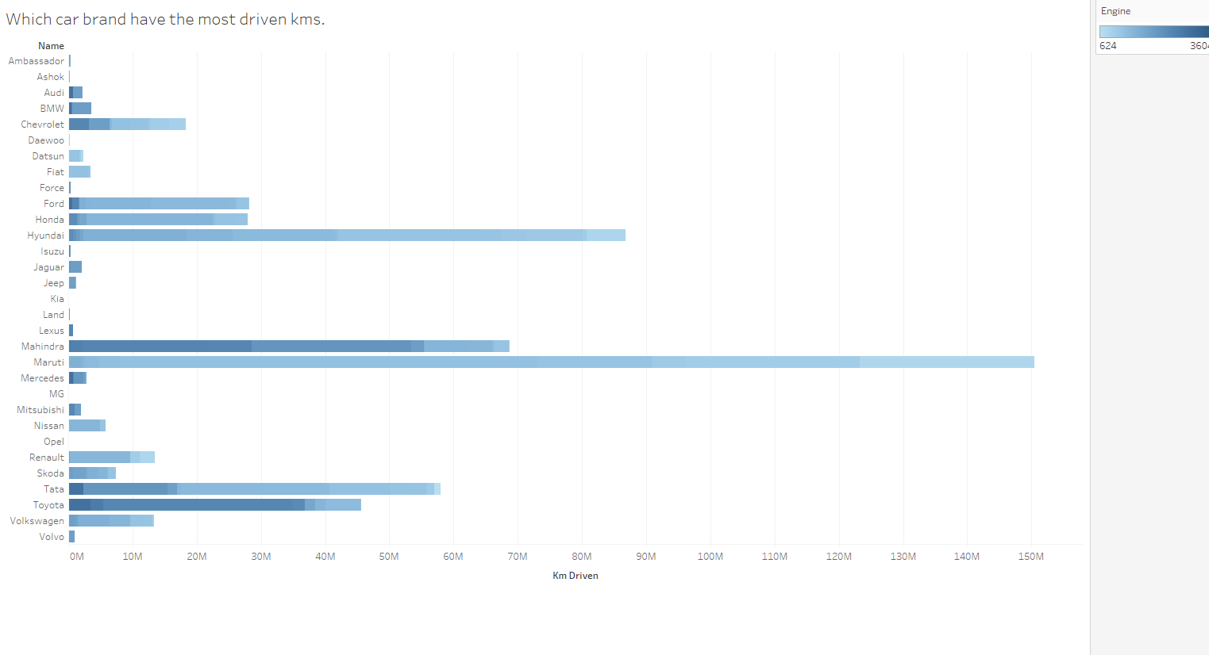
2nd Hand Car that have the total kms driven(Horizontal Bars).

Slide 6
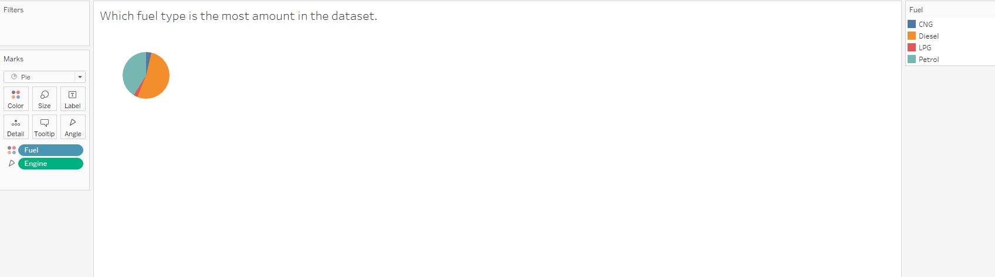
Representing fuel type data(Pie Chart)

Slide 7
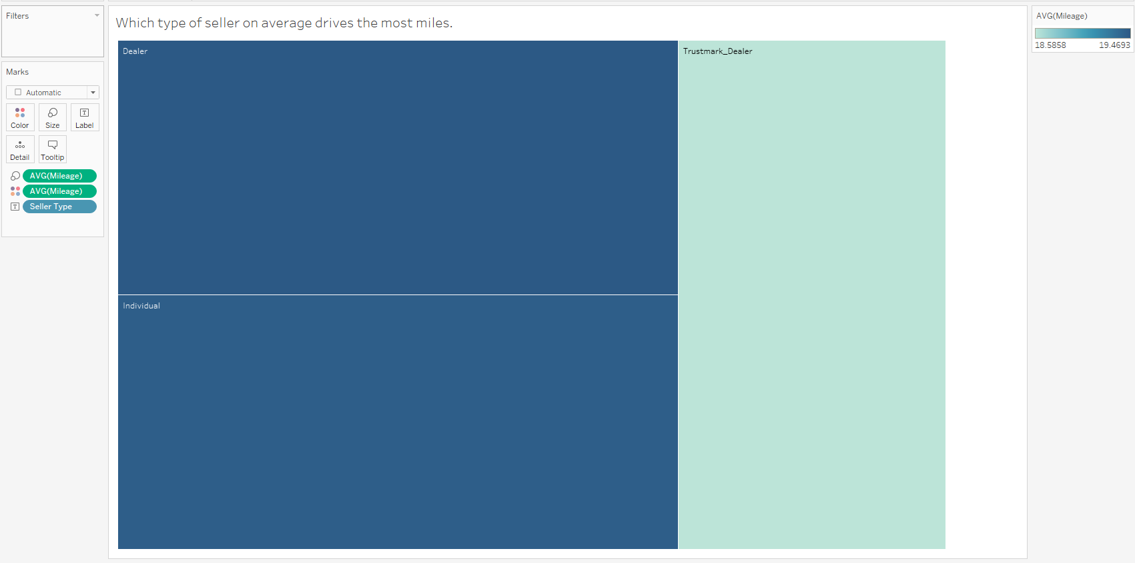
Shows which type of sellers have the least and most average mileage usage.

Slide 8
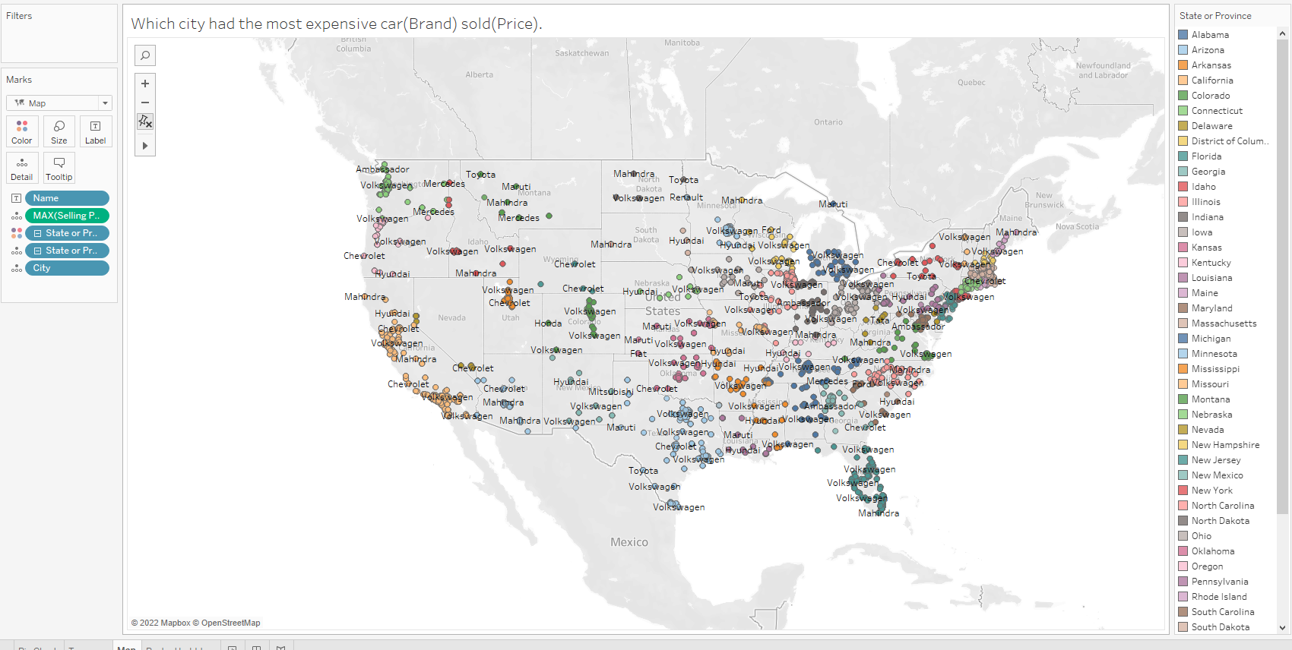
Max selling price and brand in each cities around the country(maps).

Slide 9
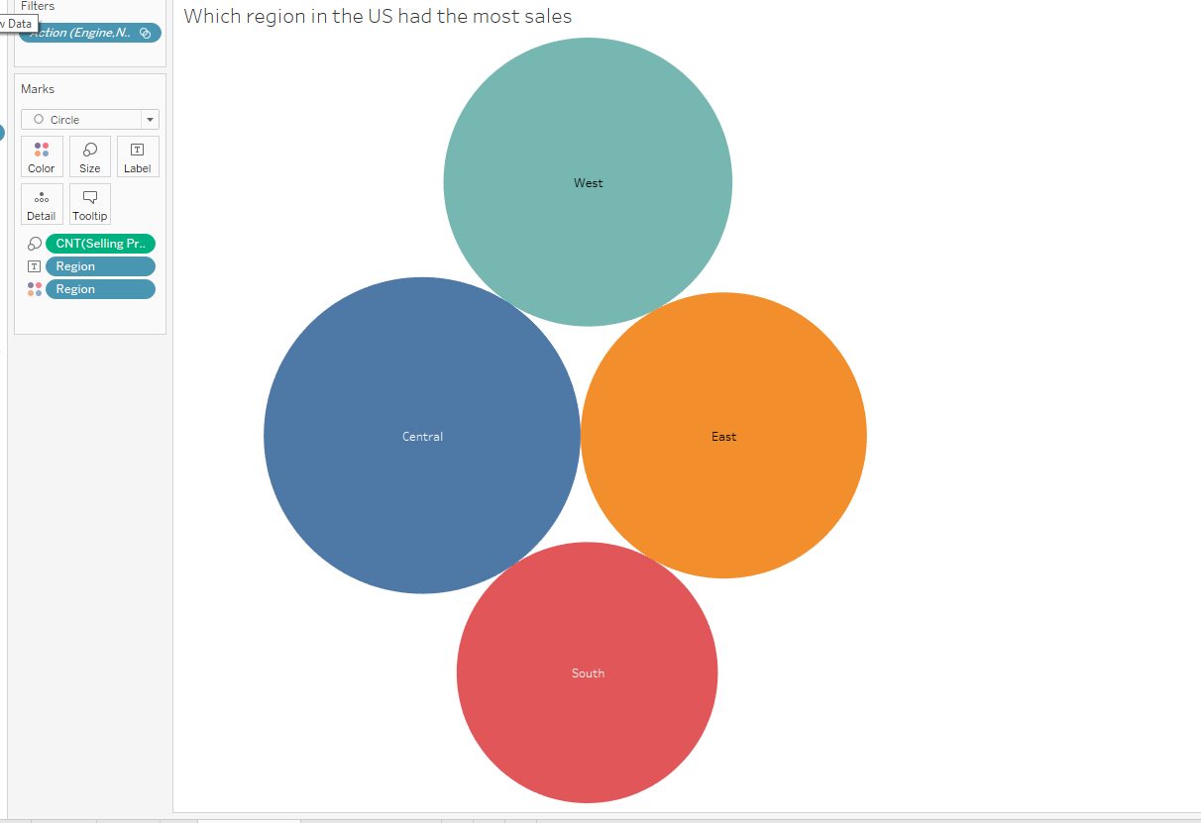
Which Region in the USA accumulates the most 2nd hand vehicles to be sold.(Packed Bubbles)

Slide 10
Visual Analysis result of problem(Python)
Developed visualization charts, Below

Slide 11
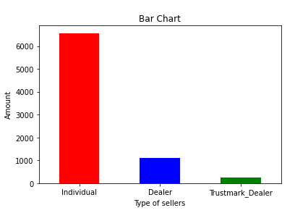
Shows popularity of each seller type(Bar Chart).

Slide 12
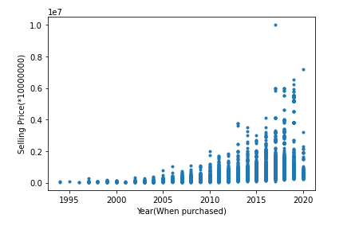
Year the car was purchased and selling price(ScatterPlot)

Slide 13
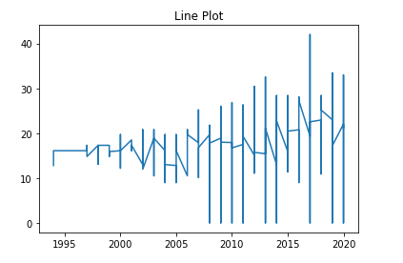
Year and mileage driving in those years(Line Plot)

Slide 14
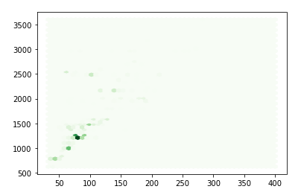
Shows relationship with engine and Maxpower of the vehicle(HexBin)

Slide 15
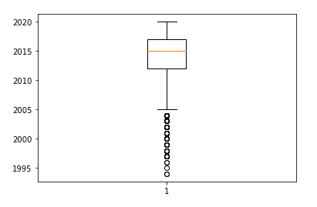
Show which years these cars was purchased(BoxPlot).

Slide 16
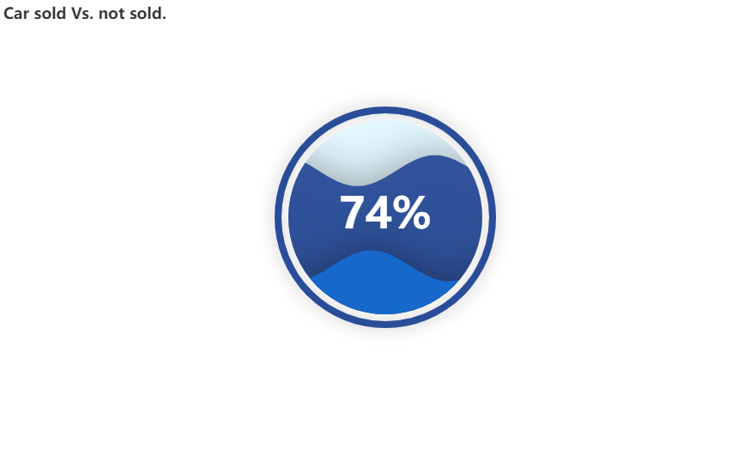
Show Percentage of Secondhand cars sold vs not sold(Liquid).

Slide 17
Conclusion

Slide 18
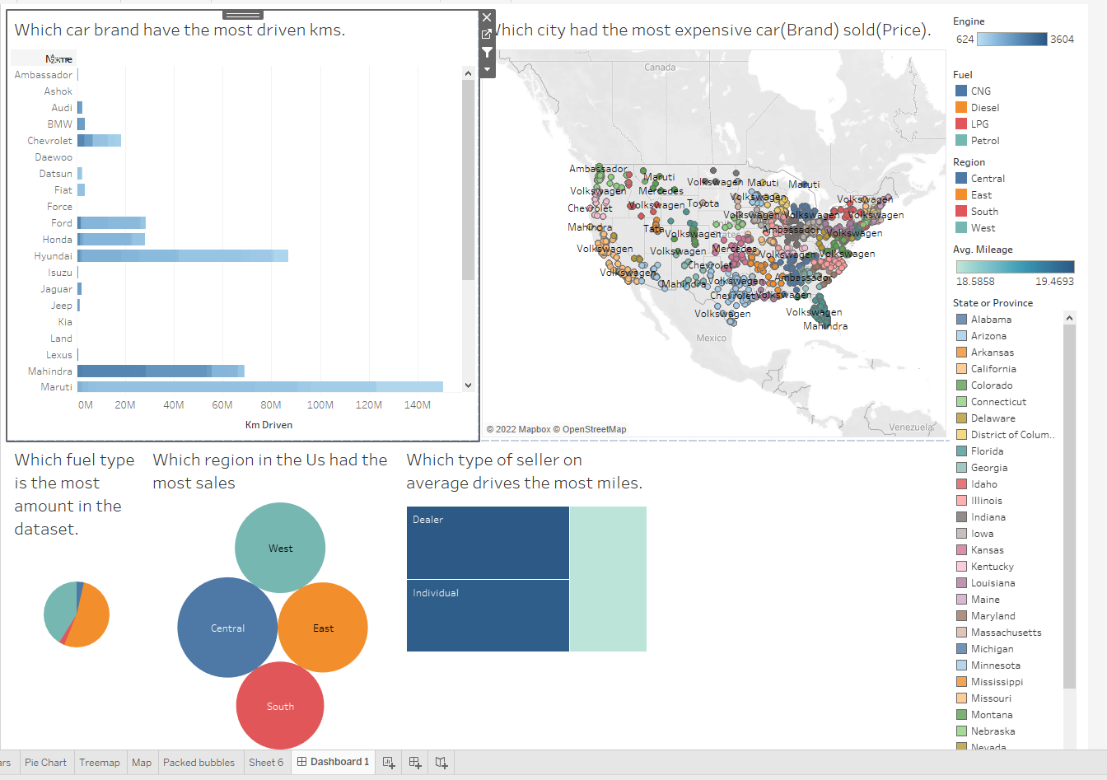
Interactive Chart w/ DashBoard(Concluding Overview of EDA)

Slide 19
The visual analysis result of problem
What is the conclusion of data analysis insights obtained through visual charts?
According to the charts, the majority of used car sellers are individuals, followed by dealers and Trustmark dealers. It appears that diesel engine vehicles are the most popular among used cars being sold. The average mileage for regular dealers' vehicles is higher than that of individual sellers, while Trustmark dealers have the lowest mileage. The central region of the United States has the highest number of used cars being sold, while the south has the least. The median year for this dataset is 2015, with most cars being sold in 2014.

